Slide 1

FEASIBILITY ANALYSIS AND PERFORMANCE TESTING OF COLLISION DETECTION ALGORITHMS FOR SATELLITES
Capstone Project Phase B
23-2-D-17
Hallel Weil
Omer Shamir
Supervisor: Mr. Ilya Zeldner

Slide 2

Introduction
Active\Old Satellites, Space debris
Satellites
Space debris
Finding possible collisions
Implementing on a satellite on-board computer
Active satellites[orange]
Inactive satellites[Blue]
Space debris[Grey]
Rocket bodies[purple]
Uncategorized[pink]

Slide 3
Introduction
Finding the minimal distance
Small time step
Approximations using polynomials

Slide 4
Algorithms
ANCAS
SBO ANCAS
CATCH

Slide 5
Expected result
Implemented, tested and ready to use algorithms
Testing system
Experiments result, feasibility of using the algorithms on satellites

Slide 6
Solution
Implementing the algorithms
2 Parts testing system
Comparing algorithms performance

Slide 7

Algorithms Implementation
Implemented in C++
Eigen for finding eigenvalues
Unit test and CelesTrak + SOCRATES

Slide 8

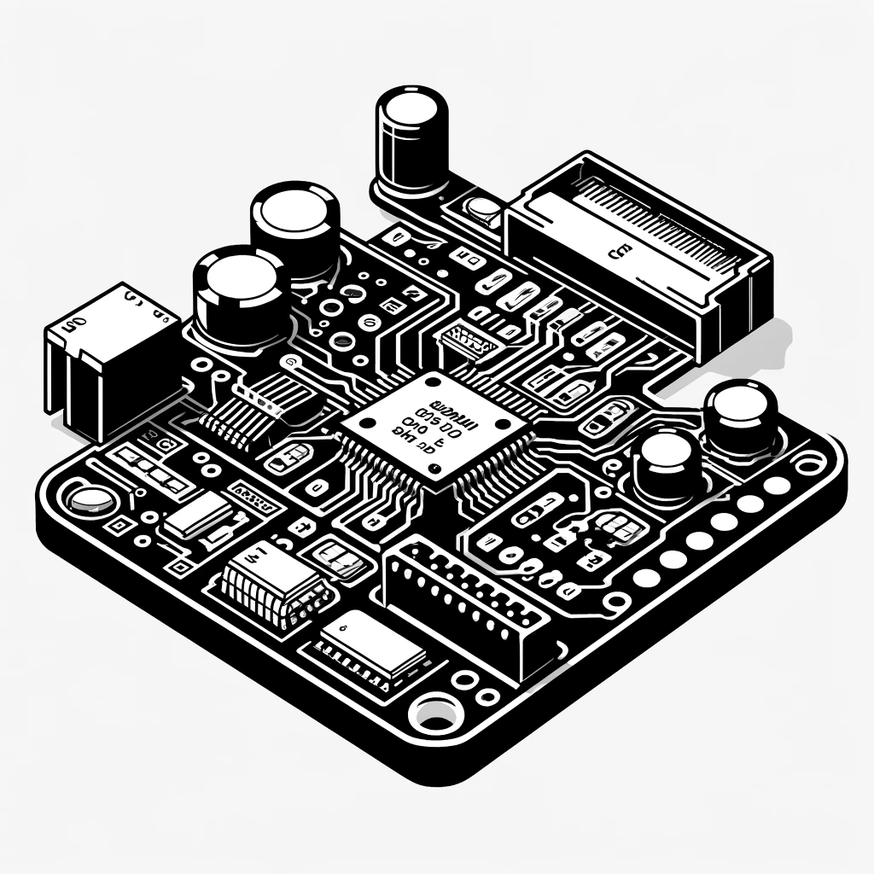
Testing System
2 parts testing system
Testing station
Tested on-board computer
User Interface
Test Creation and Management
Results Management
Database
Running tests
Running the algorithms
Testing runtime

Slide 9
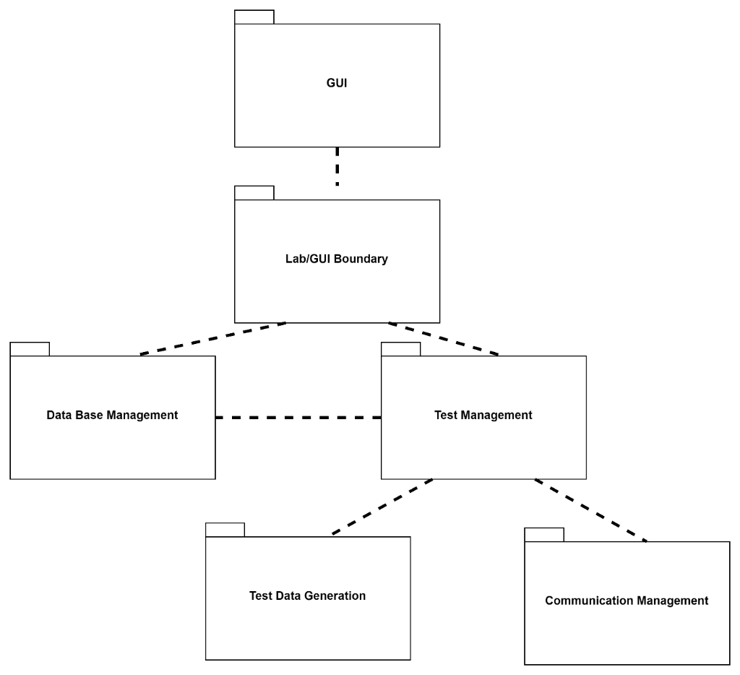
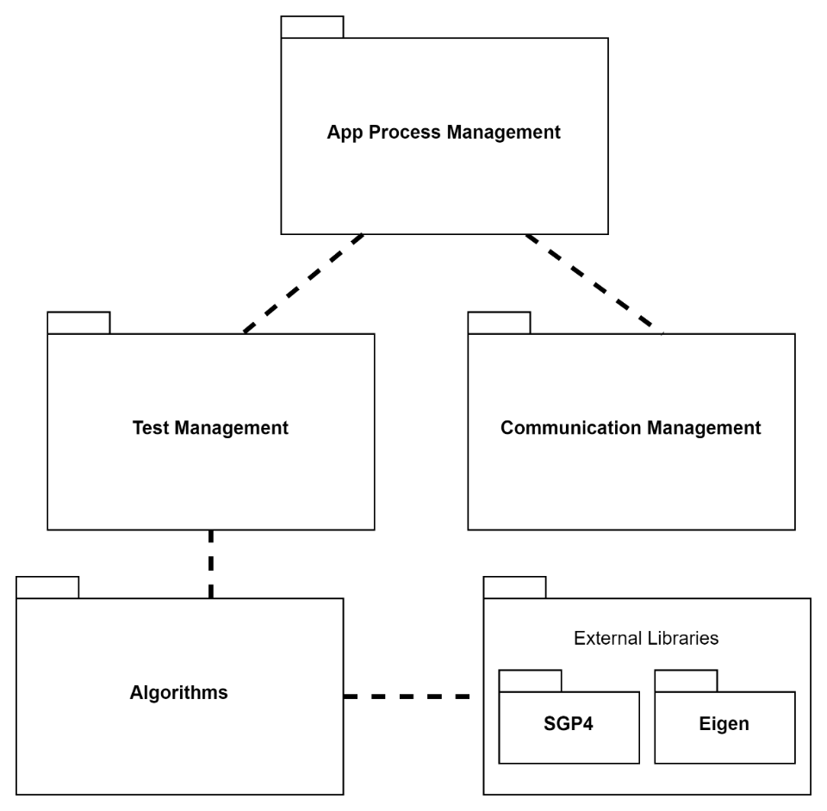
Testing System
Testing station
Tested on-board computer

Slide 10
Testing System - Communication
Defining a communication protocol
Error detection - CRC
Work on:
UDP
TCP
Local simulation

Slide 11
Testing System – Environments - Windows
Windows / WSL
TCP/UDP over Local host
Local simulation

Slide 12
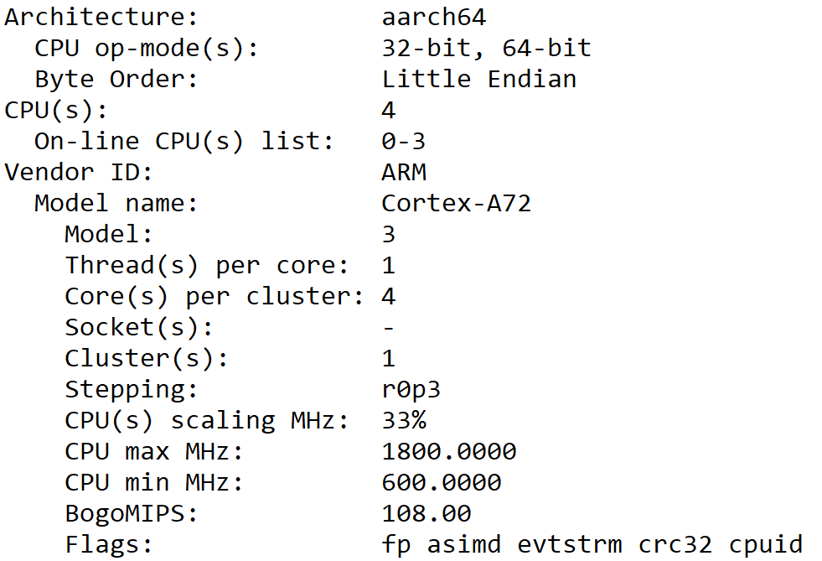
Testing System - Environments – RP4
Linux on Raspberry Pi 4
TCP/UDP
Testing Cross – Platform Communication

Slide 13
Testing System – Environments - Simulation
gem5 simulation
Open source, Community led project
Framework for computer systems simulations
Accurate timing

Slide 14
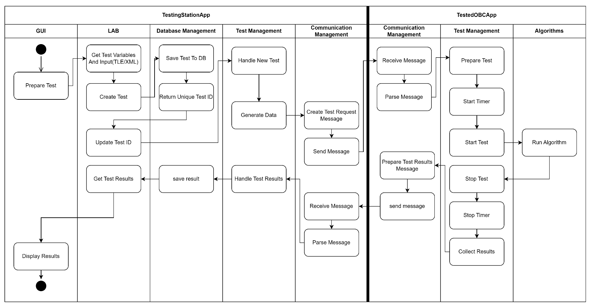
Testing System – Activity Diagram

Slide 15
Feasibility Testing Environments
gem5 simulator with WSL
Simulation script - se
 | OBC | gem5 simulation script
CPU | 32-bit ARM9 | SimpleTimingCPU
CPU Frequency | 400MHz | 400MHz
Cache | 32-KB Data, 32-KB Instruction | 32-KB Data, 32-KB Instruction
Memory | 32MB SDRAM | SimpleMemory

Slide 16
Feasibility testing - data
Catalog of objects from Celestrak - 9727 active satellites
Used around 20% - ~5700 tests
3 days to run the simulation

Slide 17
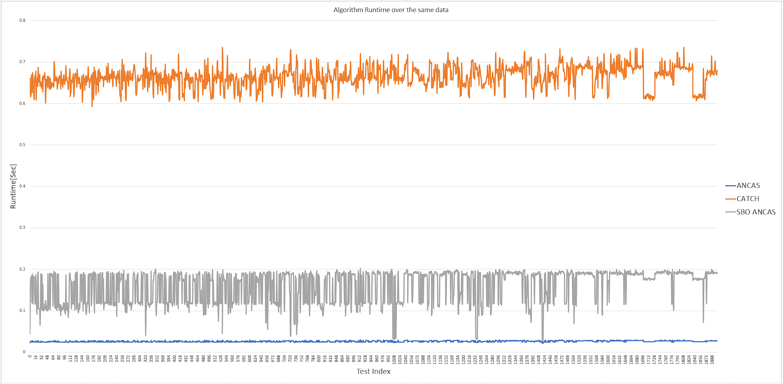
Feasibility testing - runtime

Slide 18
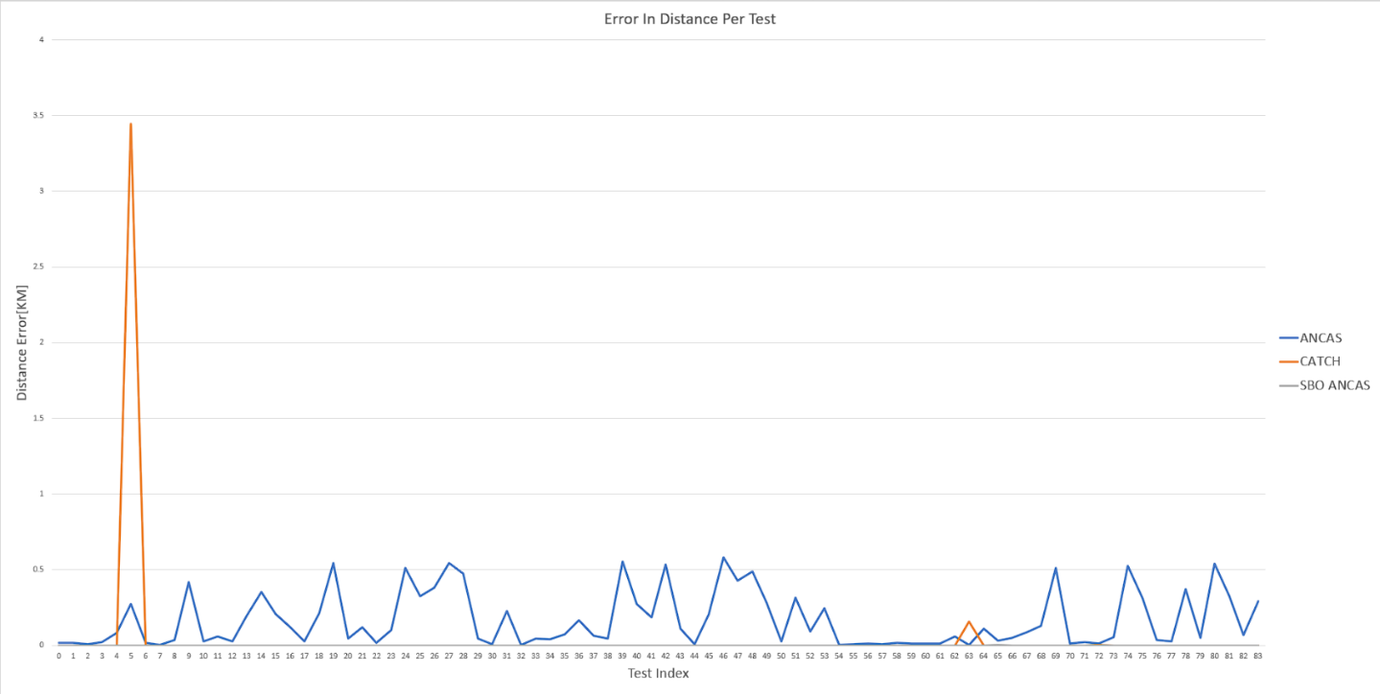
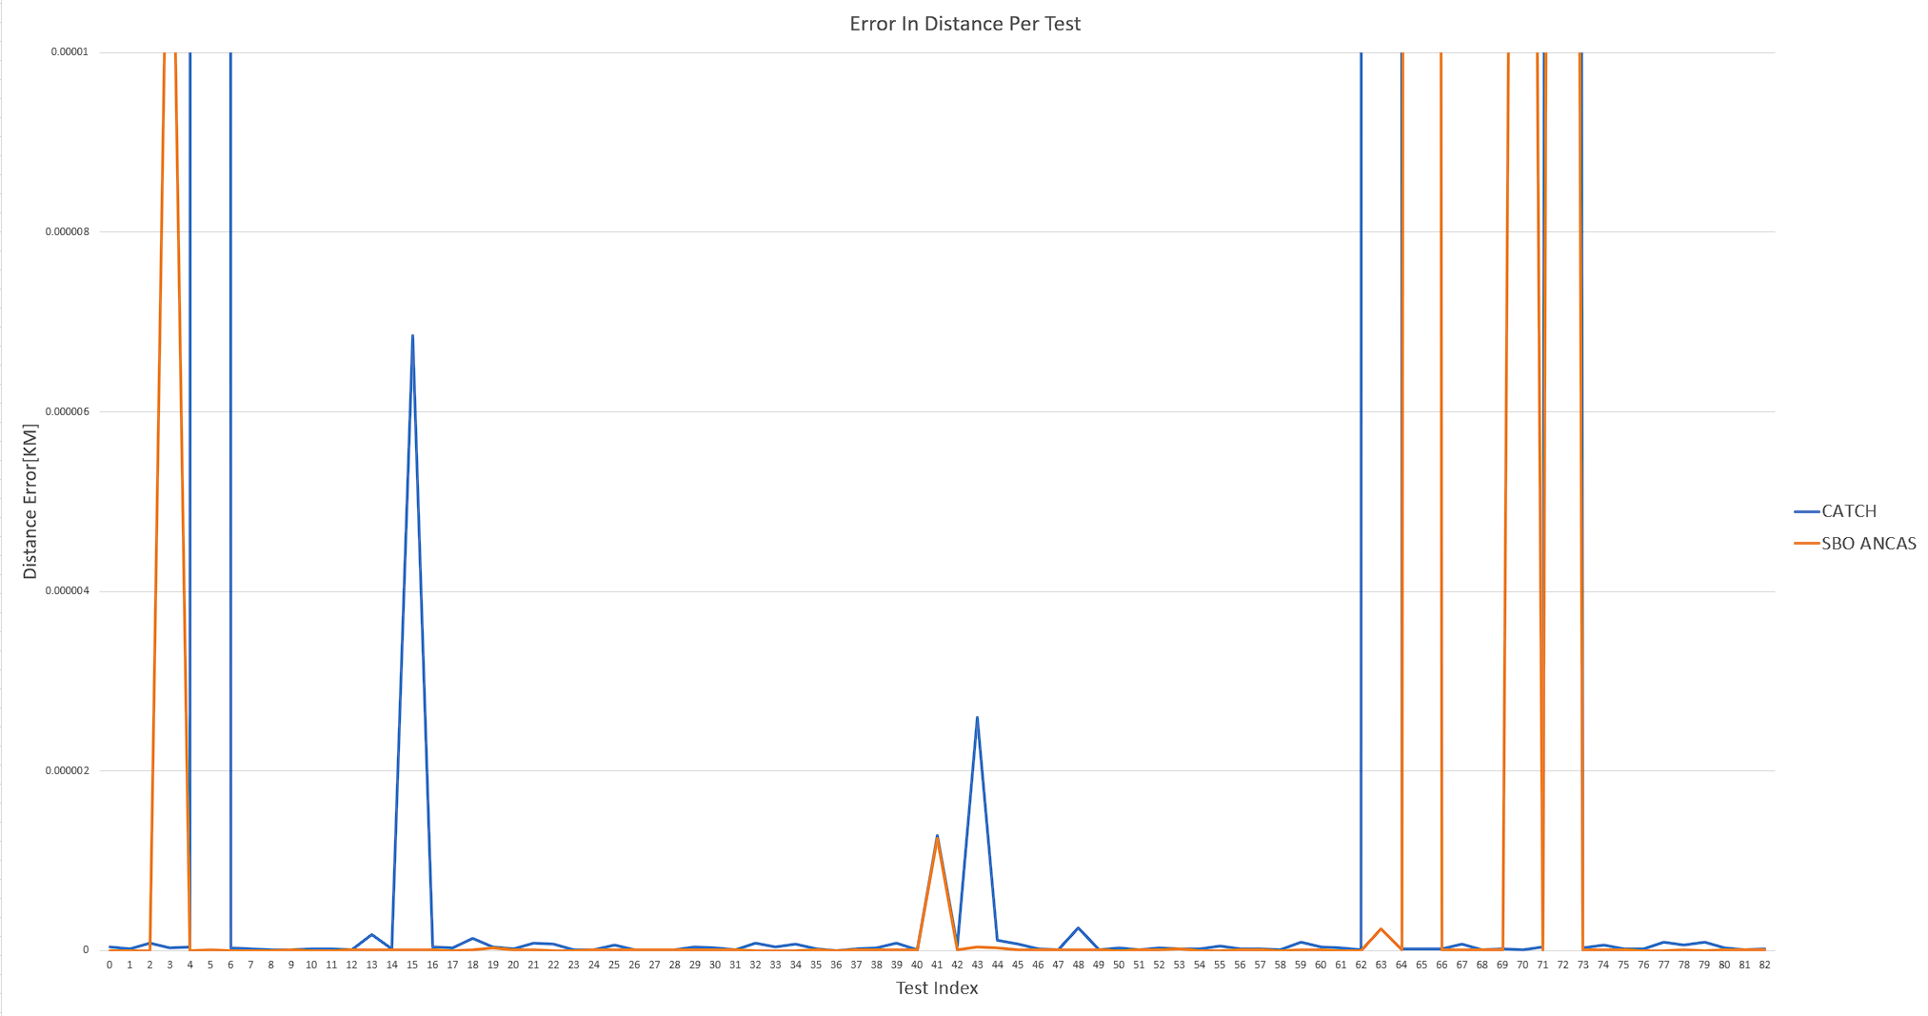
Feasibility testing - errors
Algorithm | Average Runtime[Sec] | Average Distance Error[KM] | Average #Points | Test With Distance Error > 0.00001[KM] | Test With Distance Error > 0.100[KM]
ANCAS | 0.026057568 | 0.222462893 | 3019 | 1902 | 783
SBO ANCAS | 0.159591541 | 0.007744792 | 3019 | 91 | 8
CATCH | 0.663982872 | 0.022729184 | 3019 | 41 | 12

Slide 19
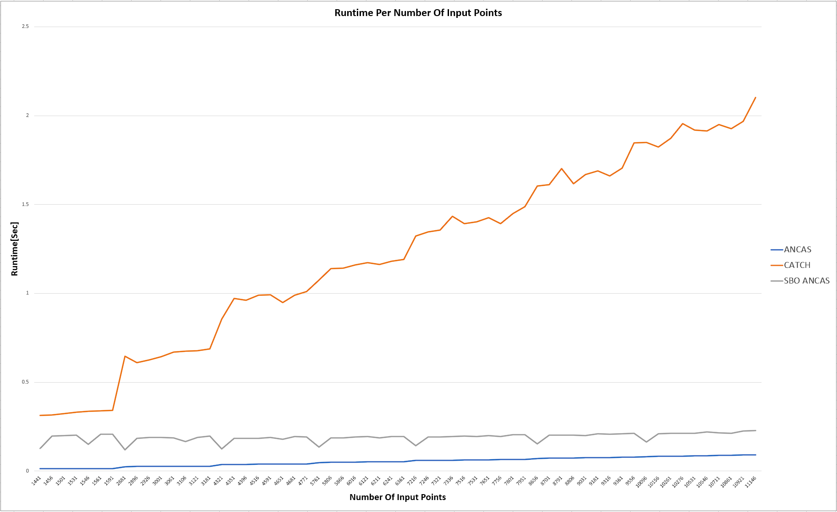
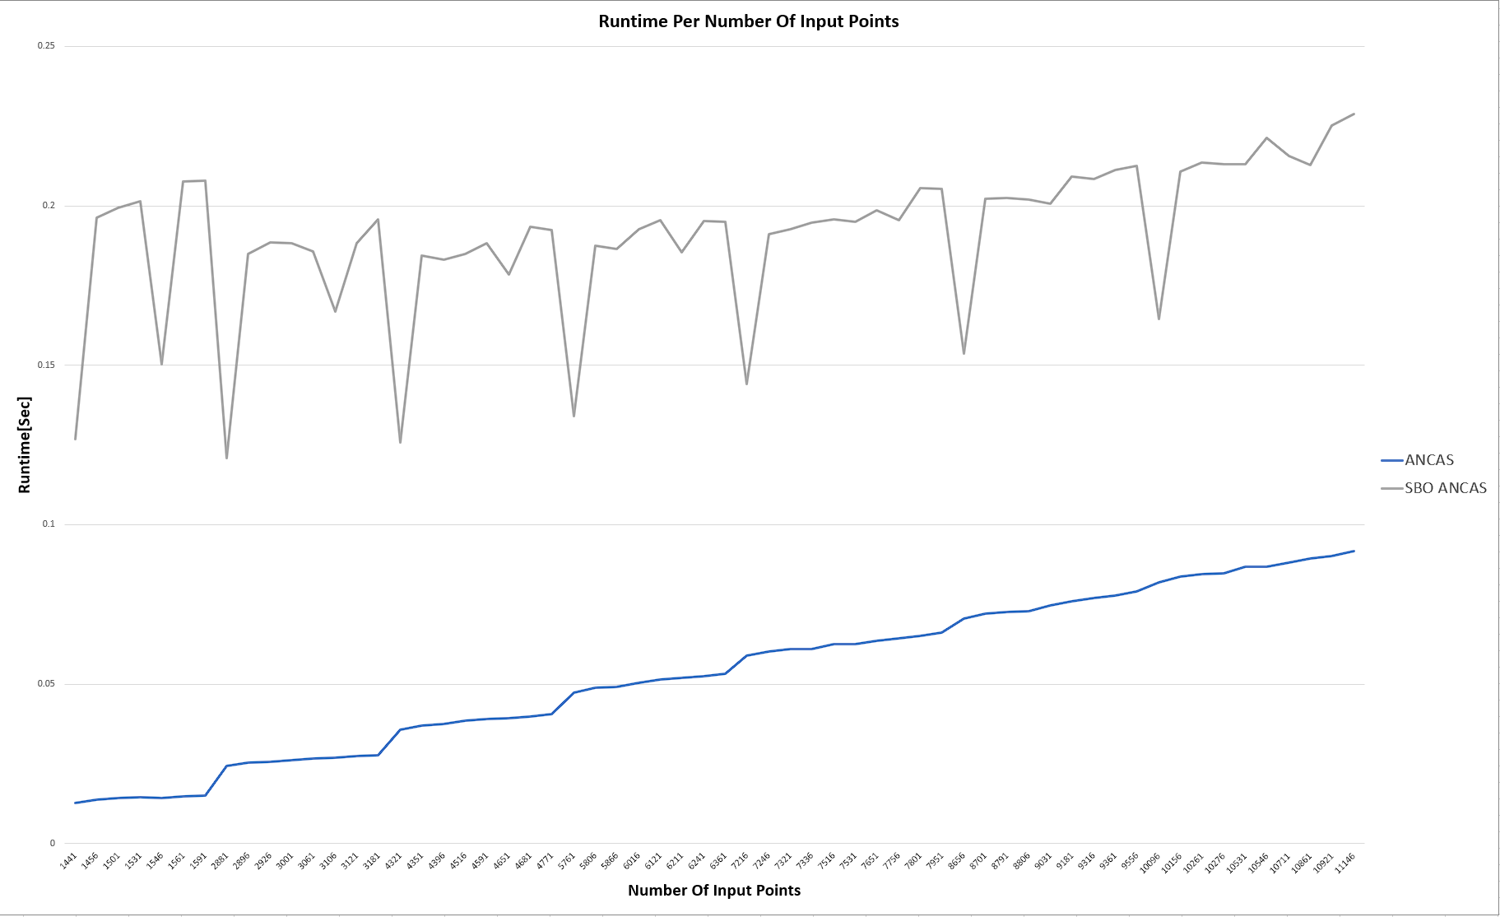
Feasibility testing – correlations
Constant time interval- changing number of points

Slide 20
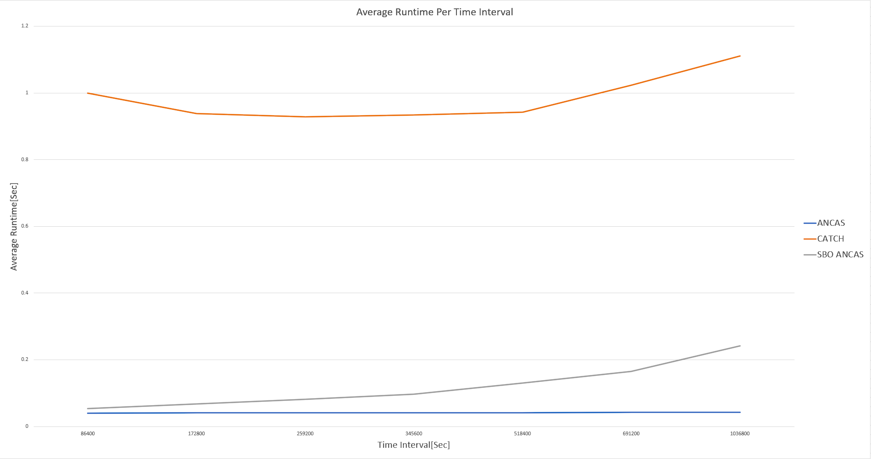
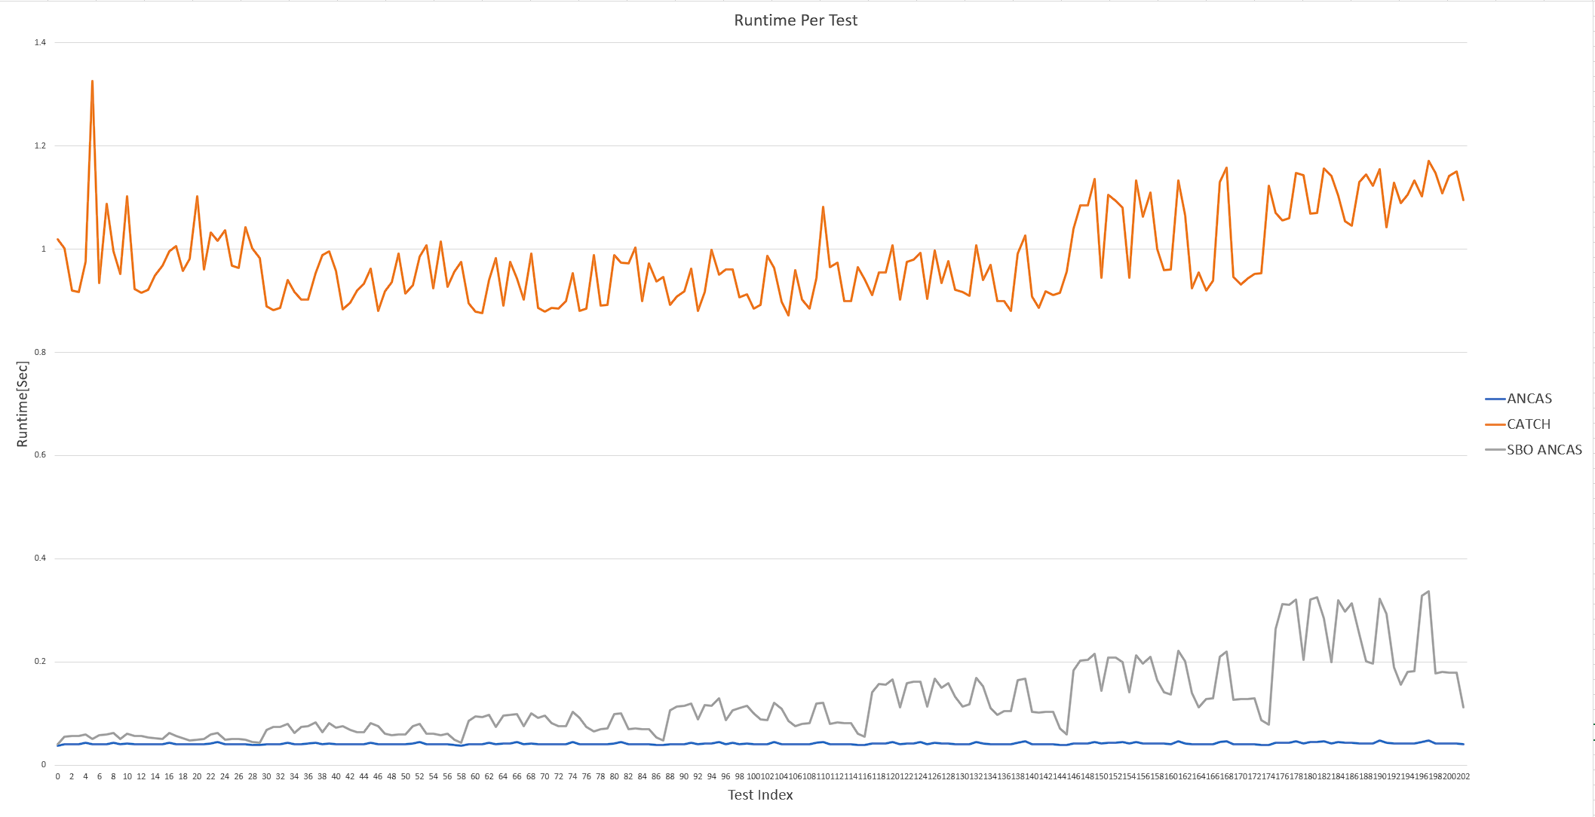
Feasibility testing – correlations
Constant number of points – changing time interval

Slide 21
Challenges
Developing for unknown / multiple systems
Types
Padding
Different functions
Testing and debugging
Unit tests
Local Simulations
Loggers

Slide 22
System Testing
Unit tests
Local Simulation with test cases
RP4 cross platform communication testing
Acceptance testing

Slide 23
User Interface – Video

Slide 24
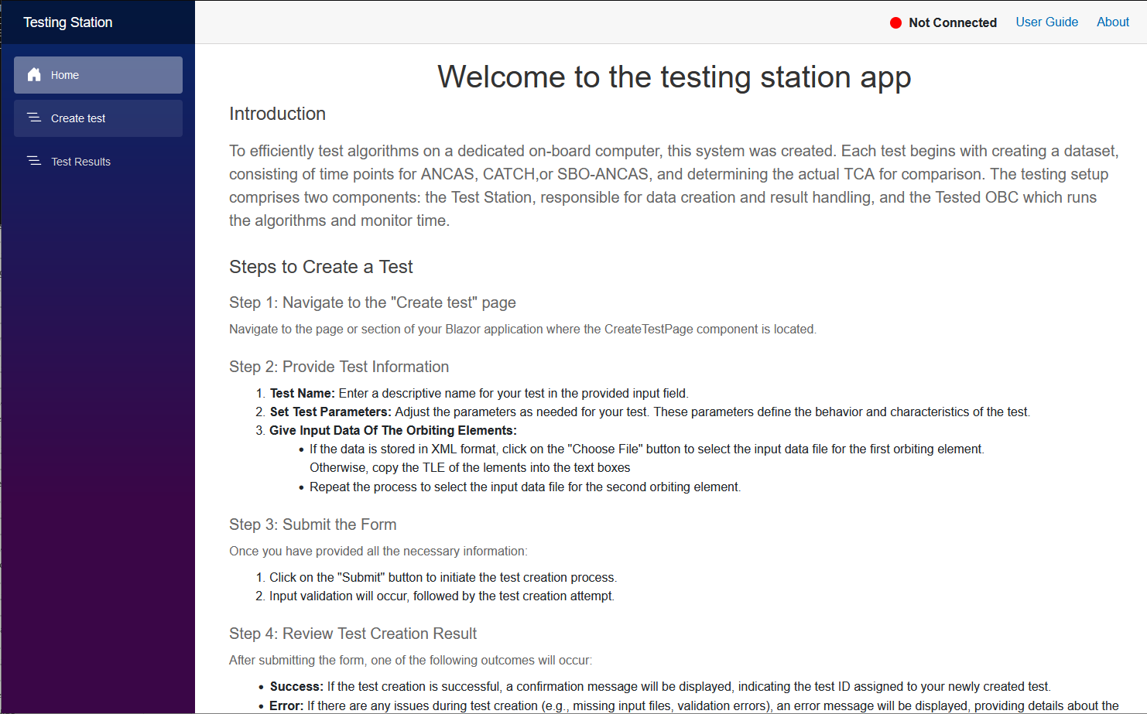



User Interface – Home Page

Slide 25
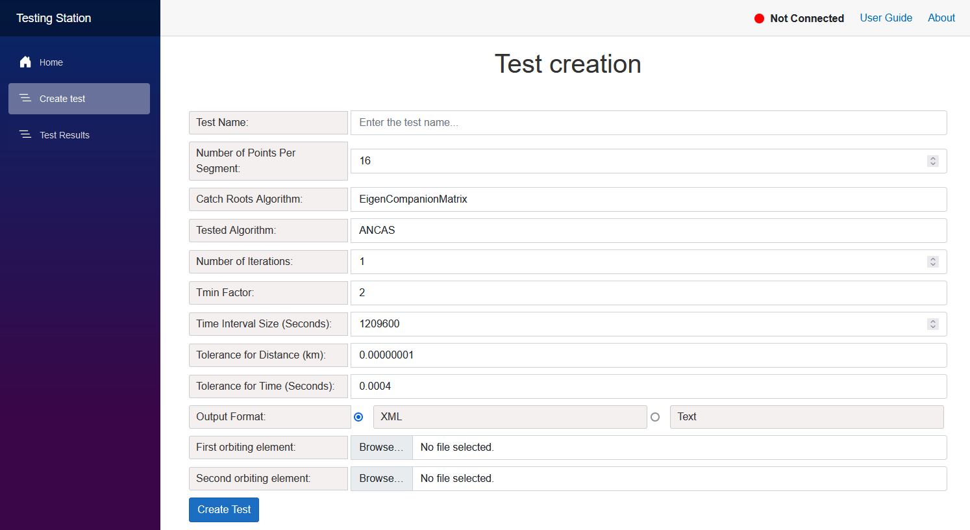
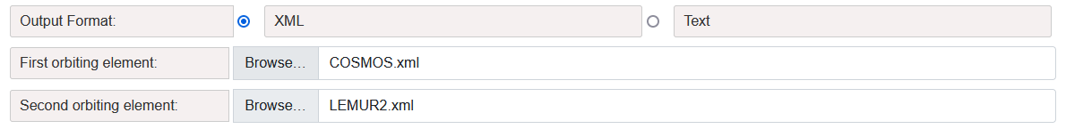
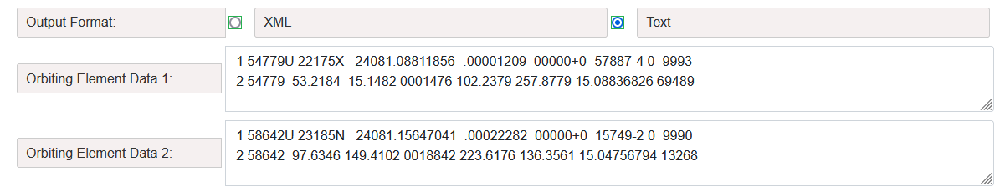
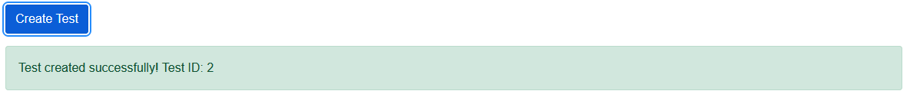
User Interface – Create Test

Slide 26
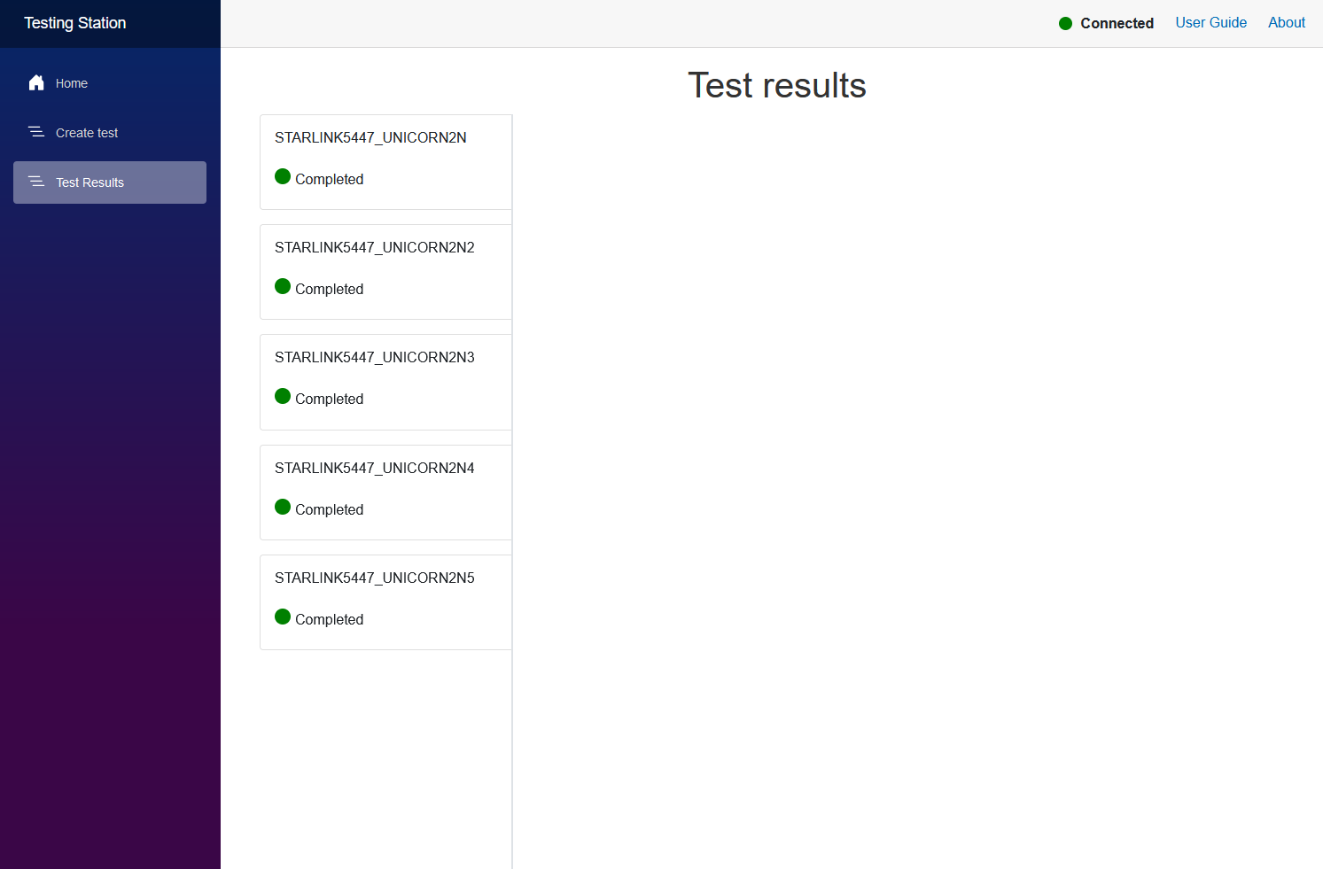
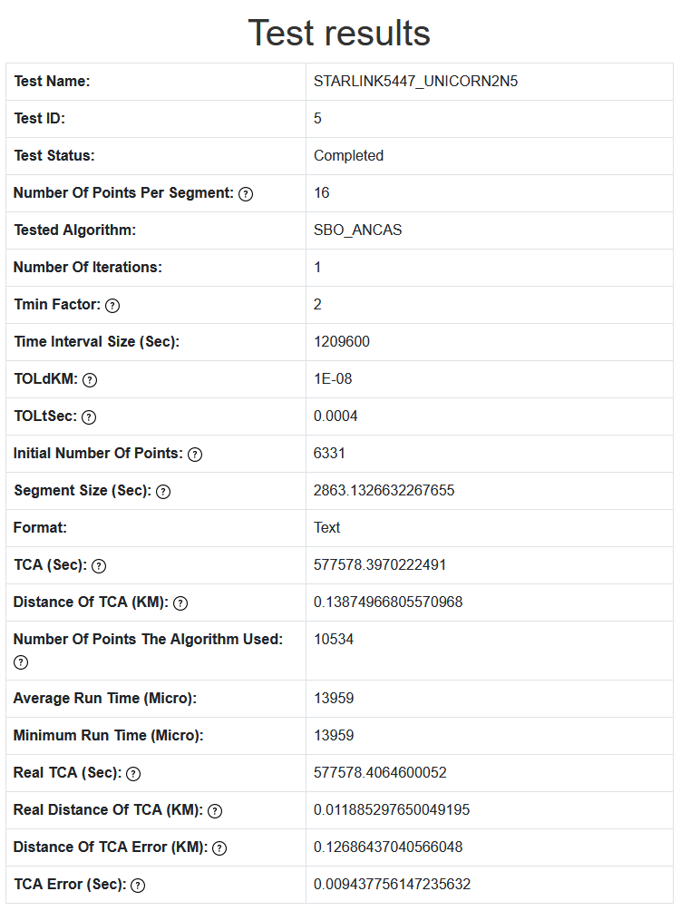
User Interface – Test Results

Slide 27
Bibliography
[1] Denenberg, Elad. "Satellite closest approach calculation through Chebyshev Proxy Polynomials." CATCH
[2] Alfano, S. "Determining Satellite Close Approaches-Part II." ANCAS
[3] Denenberg, Elad. Gurfil, Pini. “Improvements to Time of Closest Approach Calculation.” SBO ANCAS
[4] NASA on orbital debris: NASA
[5] CelesTrak: https://celestrak.org/
[6] CelesTrak Current Data: https://celestrak.org/NORAD/elements/index.php?FORMAT=tle
[7] The gem5 simulator: https://www.gem5.org/
[8] ISISPACE OBC: https://www.isispace.nl/product/on-board-computer/
[10] Our GitHub repository: https://github.com/ommersh/Final-Project

